Slide 1
presentation template
creative
PORTFOLIO
by elham adel

Slide 2
table of
CONTENT
This portfolio presents a comprehensive overview of my professional skills, projects, and achievements
about me
vision / mission
personal skills
work experience
portfolio
contact
creative portfolio

Slide 3
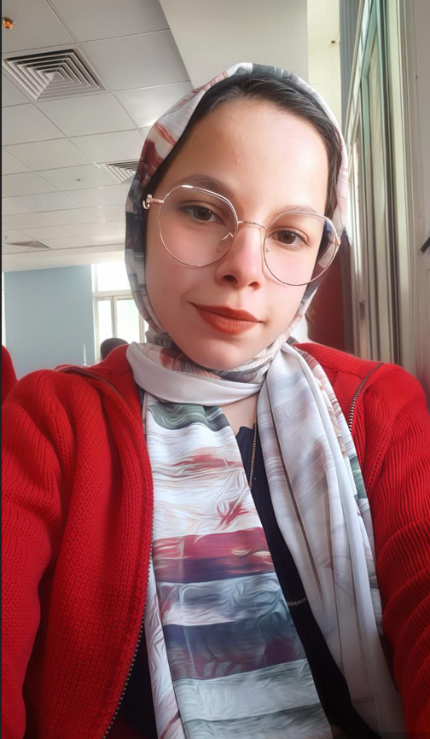
IoT Engineer | Mobile Developer |Data Analyst
introduce
ABOUT ME
elham adel
I’m a passionate technology enthusiast specializing in mobile app development, Internet of Things (IoT), and data analytics. Skilled in building applications using Flutter and Firebase, with experience in scalable architectures like MVC. Proficient in Python, SQL, and modern visualization tools such as Power BI and Tableau.

Slide 4
VISION
MISSION
To lead in IoT, mobile app development, and data analysis by creating smart, user-focused solutions powered by data-driven insights.
To deliver innovative, connected, and data-driven solutions that improve efficiency and decision-making.
more
more

Slide 5

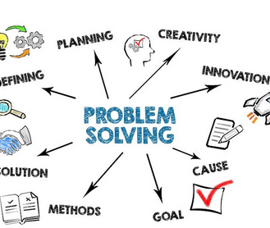
personal
SKILLS
I possess strong communication and presentation skills, with professional English proficiency that enables effective collaboration within diverse teams. I excel in critical thinking and problem-solving, adapting quickly to new challenges and environments. My ability to manage time efficiently, stay organized, and take initiative allows me to lead projects and contribute proactively to achieving goals.
TEAMWORK
PROBLEM-SOLVING

Slide 6
technical
SKILLS
🔧 IoT Development: Arduino, Raspberry Pi, ESP32, Home Automation Systems, MQTT, Node-RED, Sensor Integration, Embedded Systems
IoT Development:
Dart
Firebase
Mobile Development
📱 Mobile Development: Flutter, Dart, Firebase, MVC Architecture, REST APIs, UI/UX Implementation for Mobile Apps
📊 Python (Pandas, NumPy), SQL, Power BI, Tableau, Data Cleaning, Data Wrangling, Dashboard Design
Data Analytics & Visualization
Power BI
Tableau
Communication Protocols & Tools
🌐 Wi-Fi, Bluetooth, Zigbee, LoRa, Git & GitHub, Linux, API Integration, Cloud Connectivity (Firebase Cloud, AWS IoT Core)
Linux

Slide 7
EDUCATION BACKGROUND
2019 – 2022
2022 – 2023
2023 – 2027
High school
Foundation Year
Faculty of AI (MNU )
Graduated with strong STEM focus and excellent academic performance.
Focused on building programming and IoT basics through online courses, competitions, and personal projects.
Bachelor’s in Internet of Things Engineering (Expected Graduation: 2027).

Slide 8

work
EXPERIENCE
-Freelance Mobile App & IoT Developer (Remote)
-Worked on data analysis and visualization projects using Python, SQL, Power BI, and Tableau.
IoT Engineer
Data Analyst

Slide 9
project
PORTFOLIO
A showcase of my key projects highlighting expertise in IoT, mobile development, and data analytics.
project 01
project 02
project 03

Slide 10
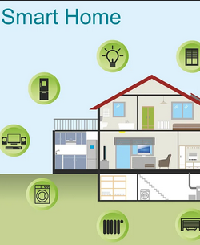
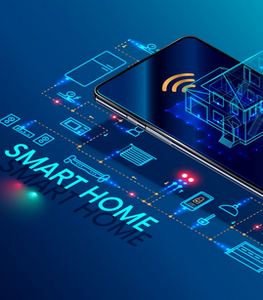
PROJECT 01
Smart Home Automation
Smart Home Automation
Developed an IoT-based system using Arduino and ESP8266 to remotely control home lighting and monitor environmental sensors through a mobile app, enabling real-time control and creating a more convenient, connected smart living experience

Slide 11
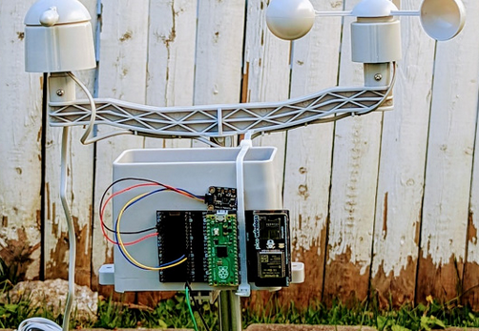
PROJECT 02
Weather Monitoring Station
Built a weather monitoring system using Raspberry Pi and multiple sensors to collect real-time temperature, humidity, and pressure data, with results visualized through an intuitive interface to provide accurate and accessible environmental insights.

Slide 12
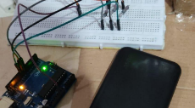
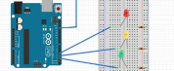
PROJECT 03
Traffic Lights System
Traffic Lights System
Designed a traffic light control system with sensor integration to optimize vehicle flow, improve road safety, and reduce congestion.

Slide 13
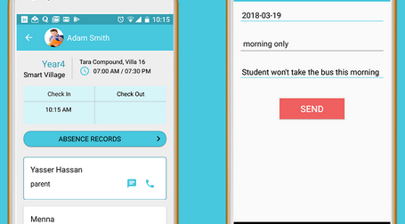
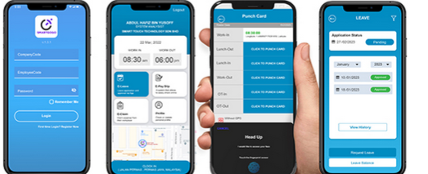
PROJECT 04
Attendance Tracking Mobile App
Developed a mobile application using Flutter and Firebase to enable real-time attendance logging and data visualization, providing an efficient and user-friendly solution for tracking and managing attendance records.

Slide 14

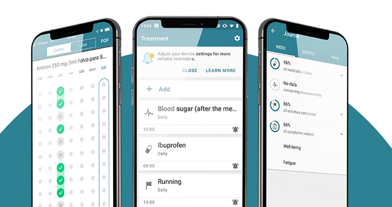
PROJECT 05
Medication Assistant App
Created a Flutter mobile app to help users manage medication schedules, send reminders, and track intake history, featuring a user-friendly interface and local notification integration for improved health management.

Slide 15
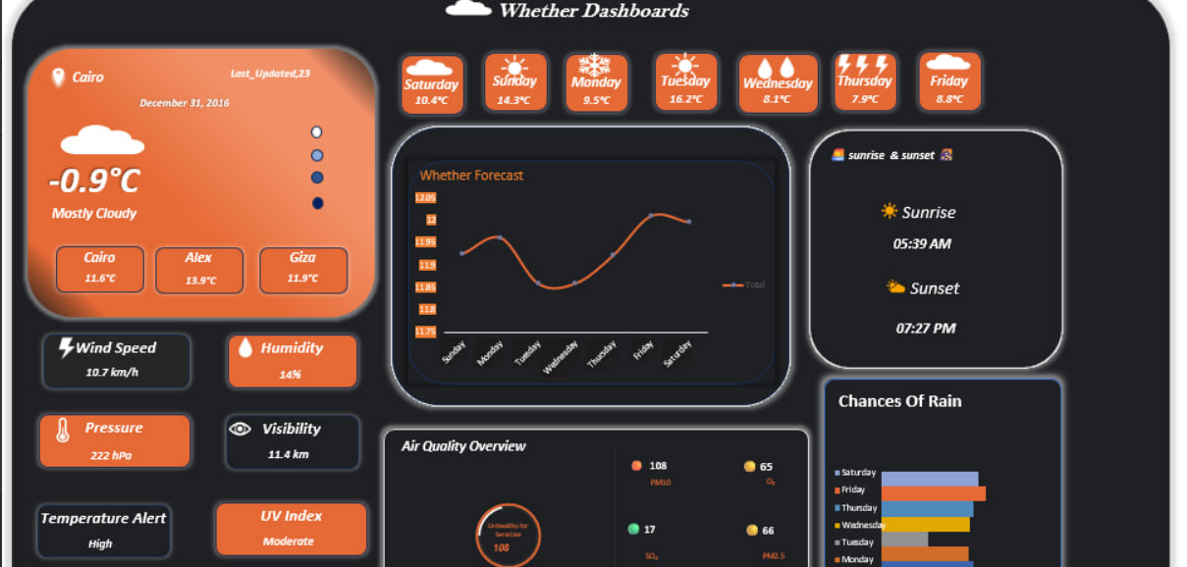
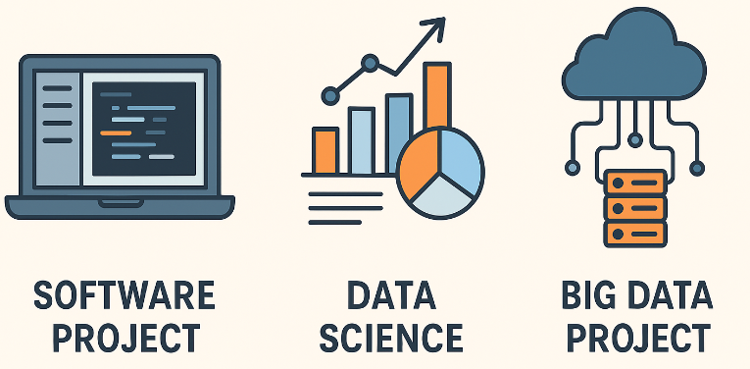
NOTABLE PROJECT
project 02
project 01

Slide 16
creative portfolio
Professional
Certifications
Cisco – Introduction to IoT: Fundamentals of IoT concepts, architecture, and applications.
Cisco – IoT & Digital Transformation: Integration of IoT technologies in modern business transformation.
NetRiders – Cybersecurity Essentials: Basics of cybersecurity principles and best practices.
EYouth (DEPI) – Data Analysis: Data cleaning, visualization, and analytics using SQL, Excel, Tableau, and Power BI.

Slide 17
creative portfolio
let's work
together
📱 +20 1559323053
📧 Email: elhamadel342@gmail.com
📍 Location: Menoufia, Egypt
🔗 LinkedIn: linkedin.com/in/elham-adel-إِلہﮩَام-44110a295
💻 GitHub: github.com/Elhamadel24

